Slide 1
OHABA 2019
Opening Remarks

Slide 2
State of the Er…State
Conference Venue
Record Membership
Public Policy
Website Platform
Additional Educational Events this year
Membership Events this year

Slide 3
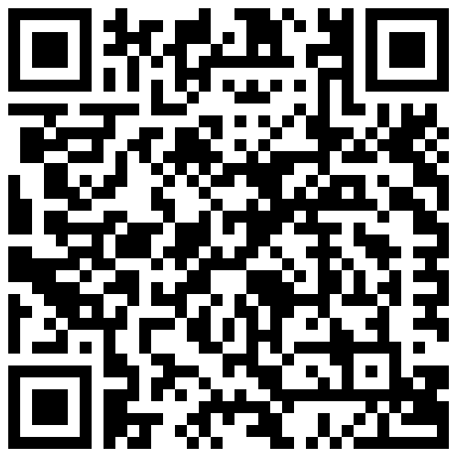
What ignites your passion for behavior analysis?

Slide 4
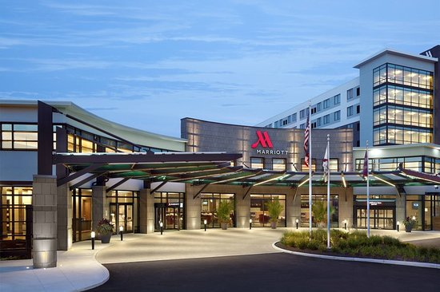
Conference 2019
RECORD ATTENDANCE! 283 attendees this year!
Beautiful New Venue
SAVE THE DATE
Marriott Columbus University Area
Friday and Saturday
February 7th & 8th

Slide 5
Membership
Membership Total: 255
Affiliate: 41
Full: 150
Student / Parent / Tech: 64

Slide 6
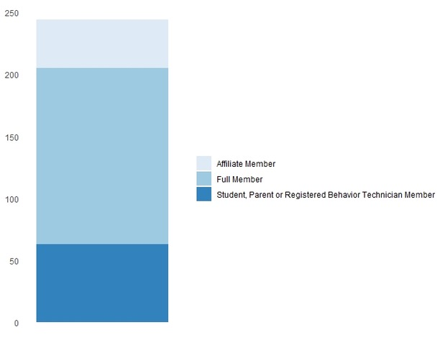
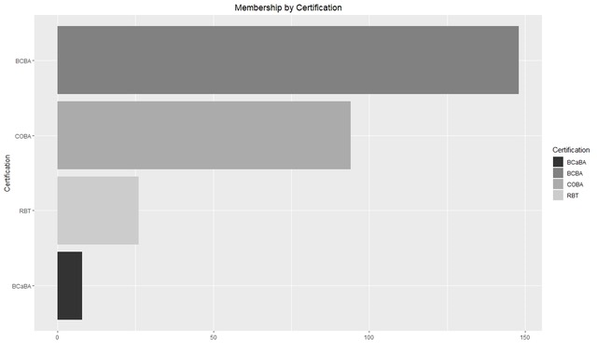

Slide 7
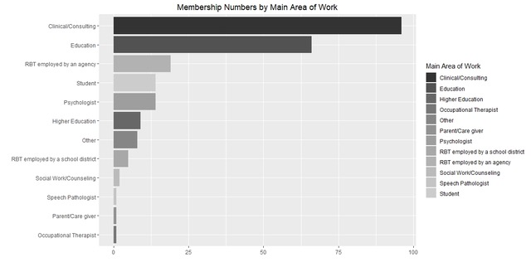

Slide 8
ATTEND A membership event!
March
Columbus
PINS Dublin, 5:30pm on 3/8/19
April
Cleveland
Bowling (location TBD), 6:30pm, 4/24/19
May
Dayton
Dublin Pub @ Oregon District, 5:30pm, 5/10/19

Slide 9
THANK YOU
Nationwide Children’s Center for Autism Spectrum Disorder
Pathfinder Progress

Slide 10
State and Regional boards are Critical to the field
Notes:
Influence public policy
Look out for interests of members
Enhance networking and connections
Improve dissemination and

Slide 11
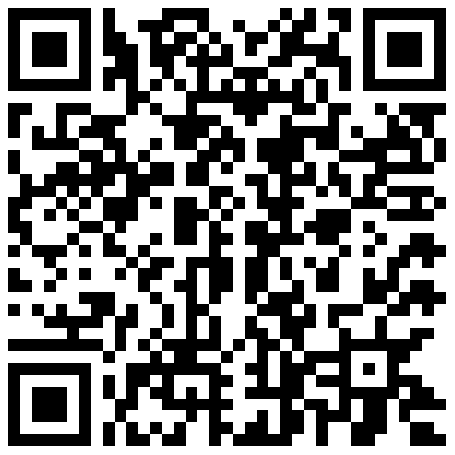
How does your role / Interests in BA interact with the board?

Slide 12
Take Ownership!!!!
#ownmyorg

Slide 13
Did you know?
Student Chair Jolanda Marx specializes in ABA with psychiatric populations…and doesn’t focus on Autism?
How could your interests overlap? How could you connect with Jolanda?

Slide 14
Did you know?
Jen Gonda, our Public Policy Chair, has research interests in the Theory to Practice Gap?
Are you interested in public Policy? Do you current conduct practice gap research? Do you want to?

Slide 15
Did you know?
Eric Anderson trains Student Teachers as a Supervisor! He is one of our Marketing and Technology Co-Chairs.
Ron DeMeuesy works for Dublin schools and has been a major advocate for getting all the paraprofessionals in the Special Education department becoming RBT certified. He is also a Marketing and Technology Co-Chair!
Did you know these awesome behavior analysts were so school – focused? Want to learn more?

Slide 16
Did you know?
Did you know this kind of resource is at your backdoor? Do you own a business or run a team who need to meet standards?
Professional Standards (incoming Treasurer) Nikki Williams, is an expert in clinical documentation auditing and Quality Assurance!

Slide 17
How do I #ownmyorg
Get involved with the Board on a committee or run for a position
Let your board know if you run into an ethical dilemma, injustice, or area of need
Reach out to your board for contacts and networking
CHALLENGE:
Take some pictures and post this weekend AND over the next year of how you own your org
Meet a speaker
Connect with a colleague
Chat with a board member
Meet a sponsor or exhibitor
Bring up an important issue

Slide 18
How do you introduce Dr. Heward?

Slide 19
Dr. Heward – Evolving Socially relevant behavior analysis
Well he DOES have a student award named after him with one particularly awesome state organization…

Slide 20
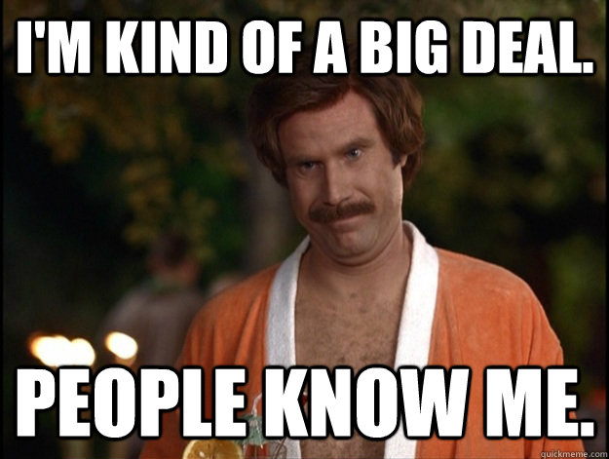
Dr. Heward – Evolving Socially relevant behavior analysis
Has ignited and continued the literature on special education and children’s classroom needs

Slide 21
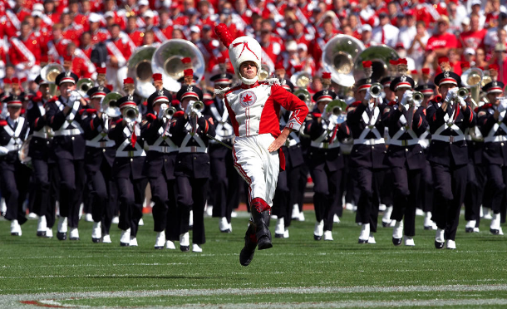
Dr. Heward – Evolving Socially relevant behavior analysis
Is an Ohio State Professor Emeritus

Slide 22
Dr. Heward – Evolving Socially relevant behavior analysis
Presents INTERNATIONALLY!

Slide 23
Dr. Heward – Evolving Socially relevant behavior analysis
Revolutionizing special education instruction

Slide 24
If you have to do the impossible…
Use some of his own research to introduce him!

Slide 25
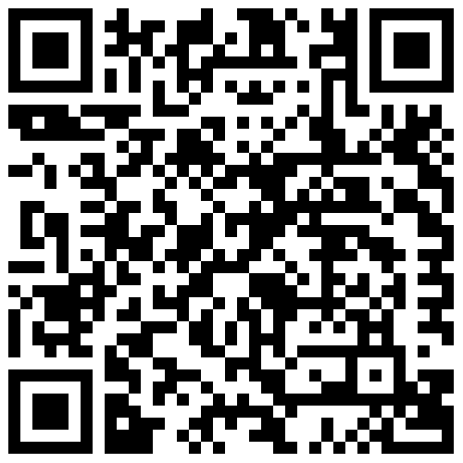
ASR! What contribution to BA is the first one you think of when you think of Dr. Heward?

Slide 26
But should that be?
Probably not.
01
There are really too many to detail.
02
Let’s see if you were paying attention.
03

Slide 27
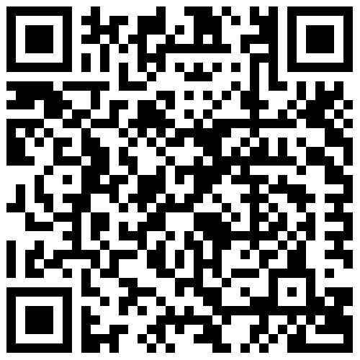
ASR! Which of these did I mention in my presentation?

